Slide 1
Global Innovation & Transformation Toolkit
DRAFT
October 2020

Slide 2

Welcome to the Global Innovation and Transformation Toolkit
  Innovation and transformation are key areas of focus for many corporations as they strive to grow revenues and manage their bottom line, especially during uncertain and volatile market conditions. Innovation should primarily serve the organization and its business objectives, while establishing the right environment for nurturing and encouraging a culture of groundbreaking innovation and creating new business opportunities. Innovation and transformation also aids in attracting and retaining top talent, engages professionals in an exciting way and provides a forward-looking work experience.
This Global Innovation and Transformation toolkit provides the basic tools for the transformation process with a focus on services business in financial, professional or legal. It is intended to help in-house transformation/innovation leaders and their teams to achieve their innovation and transformation vision.
Our aim is for the toolkit to:
Be enjoyable
Be easy to use
Provide you with useful tools
Allow you to collaborate with other businesses, countries or services
  Please note that this is a select list of all tools and solutions available in the market that have been tried and tested and found useful. Innovation and transformation cannot be driven by a toolkit alone. Transformation is about people. The key is the corporation’s commitment to innovation and transformation demonstrated through investments, leadership, resources and most importantly the underlying culture. Success will be achieved through practitioners enthused and dedicated to delivering differentiated, high quality, tailored and insightful services, leveraging a wealth of innovative tools, technologies and processes.
  If you have suggestions, insights or other input to share for future updates, please contact us. We look forward to continuing to work with you on driving innovation and transformation across the corporation.
Nita Sanger
Chief Executive Officer
Idea Innovate Consulting
Mobile +1 646 262 9717

Slide 3
Approach to Global Innovation and Transformation – Six D’s
SENSING
SHAPING
SEIZING
BUILD UNDERSTANDING
SHAPE CHOICES
MAKE DECISIONS
Articulate. Scope. Align.
Explore stakeholders
Synthesize ideas into insights
Prototype hypotheses
Select best hypotheses
Create new value
?
Discover & Analyze Market
Define Strategy & Outcomes
Design Approach
& Detail
Distill, Iterate
& Learn
Decide &
Evaluate
Deliver & Integrate
WHY?
WHAT IF?
HOW?
Refer to the Customer Journey
Involve the right stakeholders
Evaluate value proposition
Use a diversified pool of testers
Evaluate a
business case
Ready for
globalization
Discover and Analyze Market: Get to a common understanding on what is happening in the market, the customer segment and understand corporation’s view on how it will impact their business and services they offer customers
Define Strategy and Outcomes: Define the desired outcomes and create an understanding of the problem and/or hypothesis about the current process and identify the stakeholders involved. Frame the problem, map the big picture and explore solutions.
Design Approach & Detail – Explore in a directed way, various technologies and user experiences that could produce a solution different than what is expected. Imagine what the solution would look like by doing research and interviews with users, using Design Thinking techniques.
Distill, Iterate & Learn - Prototype the hypotheses. Test, refine and test again to filter out what’s not useful, usable or appropriate in order to get down to the essential value.
Decide & Evaluate - Evaluate potential solutions. Select the one that exceeds expectations, embodies the aspiration, and offers the best value.
Deliver & Integrate – Determine approach for sharing the solution with the practice. Deploy to practice in a systematic fashion
3

Slide 4
Global Innovation and Transformation Tools
10-12 Week Experimentation Cycle - Tools are categorized to aide each phase of the cycle
?
Discover & Analyze Market
Define Strategy
& Outcomes
Design, Approach & Detail
Distill, Iterate & Learn
The Five Whys
SPICE
iCafés
Five E‘s
Focal Question
Ecosystem Maps
Analogous Solutions
Hackathon
Decision Tree
Business Model Canvas
Extreme Users
Innovation Challenge
2x2 Matrix & SWOT
Brainstorming
Design Brief – 5P
Journey Maps
TRIZ
Value Proposition Canvas
Doblin 10 Types
Synthesis
SIT
Mind Map & Flower Association
IDEO Design Model
Innovation Ambition Matrix
Service Safari & Shadow
Low Fidelity Prototype
Innovation Question Matrix
Scenario Planning I
Storyboard & Service Blueprint
FastTrack
Scenario Planning II
SCRUM
A Day in the Life of…
Extreme Wishing
Semantic Intuition
Triggered Brainwalking

Slide 5
Collaborative Tools & Assets
Design Principles
TTPPEE Analogy
Strength Finder
6 Thinking Hats
Fact or Fiction
Your Everyday Innovation
Power Point Karaoke
Photo Introduction

Slide 6
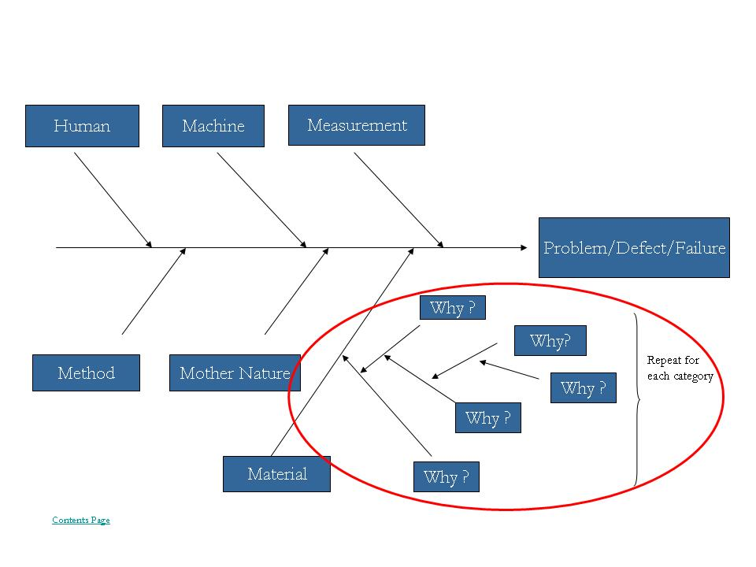
Discover | Define | Design | Distill
The Five Whys
Why?
How?
Can help break down a daunting problem into its most basic form, usually a process, which is, in most cases, much easier to work with and find a solution for
Start with identifying the main problem
Then begin an iterative process of asking why (generally 5 times, hence the five whys):
  First why on the problem
  Second why diving more in-depth on the first why
  Third why on the second why
  Fourth why on the third why
  Fifth why should allow user to easily identify the root cause
By the logic of an iterative process, this tool can be continuously used for a sixth why and so forth, or less than five whys depending on which why uncovers the root cause
A variety of diagrams and visuals can help guide the process such as the fishbone (a.k.a. Ishikawa diagram)
What?
The 5 whys is a tool to discover and dig deep into the core root cause of the problem that has been identified
6

Slide 7
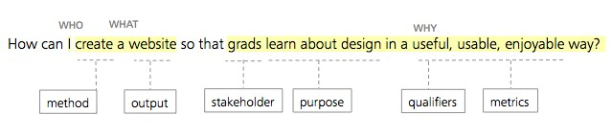
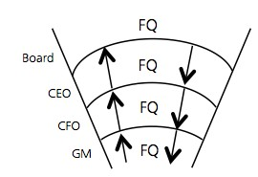
Discover | Define | Design | Distill
Focal Question
Why?
How?
It challenges assumptions within a Project Statement
and turns it into a clear, concise directive
Builds clarity and align expectations across all stakeholders
Creating Focal Question is an iterative process of choosing between WHO, WHAT and HOW:
Critical elements to consider and ensure they interrelated
Choose words carefully; keep it simple and avoid business jargon
Stakeholders drive the ‘WHY’ – work backwards
  Complex projects have multiple stakeholders; create separate FQs based on what’s relevant to each. These can be nested to illustrate interconnectedness
What?
A scoping tool to clarify and state the problem the project is aiming to address in one sentence:
  WHO is accountable to deliver the action/outcome
  WHAT the action is to be accomplished
  WHY the action is being designed for the stakeholder
How can WHO WHAT so that WHY?

Slide 8
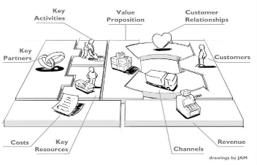
Discover | Define | Design | Distill
Business Model Canvas
Why?
How?
Use the business model canvas as part of the design process to visually facilitate discussion of ideas and potential directions to take the business
Use the 9 components of the Business Model Canvas:
Customer Segment: the users targeted by your business model
Value Proposition: value (services/products/processes) your business will create for your customer segment
Channels: the interactions or touch points
Customer Relationships: relationships created with clients/customers
Revenue Streams: how to capture the value that your customers see from your business model
Key Resources: your business’ core infrastructure and assets
Key Activities: your business’ core tasks to be done
Key Partners: core (groups of) individuals to leverage your business
Cost Structure: the different components of costs necessary
What?
A holistic approach to conceptualize new business models that considers the relationships between elements
The Business Model Canvas is a strategic management and entrepreneurial tool. It allows you to describe, design, challenge, invent and pivot your business model
Created by Osterwalder & Pigneur, 2010

Slide 9
Discover | Define | Design | Distill
Design Brief – 5P
Why?
How?
To ensure that project participants have a clear understanding of project parameters and are aligned to purpose
The 5P Framework:
Purpose
  Why are you undertaking this project?
  What goals/objectives do you hope to achieve for both organizations and its customers?
  How big is the Opportunity?
People
  What does the Business Owner want to achieve?
  What goals will be achieved for organization & its customers?
  Who will make up the team and who are the key stakeholders?
Place
  In what situation will customers be using the service experience? – List some of the scenarios
  What related projects and dependencies exist already?
  Is there a project dedicated collaborative workspace?
Performance
  Are there any specific measures that the organization is aiming to achieve in undertaking the project?
Problems
  What known/assumed problems are in the current service?
  What resources are needed to ensure success? Procured?
  What are the known/assumed obstacles to success?
  What issues/limitations and risk factors need to be considered?
  Strengths/Weaknesses? What are the related dependencies?
What?
One-page summary that clarifies: business intent, aspiration, goals/objectives, obstacles, practical approach and identifies potential project team
Generate a Design Brief through a co-design session with project owners, key stakeholders and the team using the 5P framework and Co-design Scoping tools
Revisit the Design Brief often to ensure that the project scope objectives match what is being delivered

Slide 10
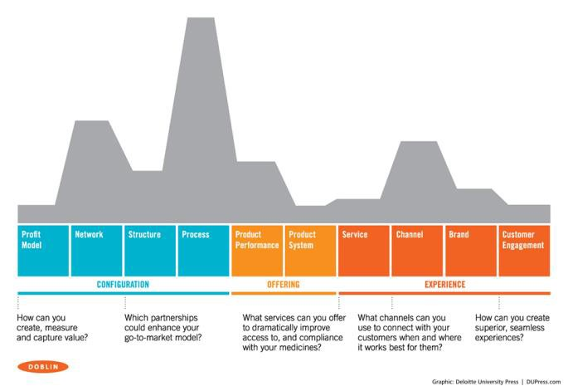
Discover | Define | Design | Distill
Doblin Ten Types of Innovation
Why?
How?
Ten Types of Innovation will help identify different opportunities to develop innovation in various areas of your business – mix and match different types of innovation to create something truly unique
When determining the scope of your innovative process, consider how many out of the ten types of innovation that you wish to incorporate –the more types you touch, the more difficult to copy your offerings.
The ten types of innovation are as follows:
Profit Model
Network
Structure
Process
Product Performance
Product System
Service
Channel
Brand
Customer Engagement
What?
Designed by Doblin, a U.S.-based innovation consultancy, the Ten Types of Innovation is a framework that gives 10 different ways that a company can innovate
Often times innovation is based only on the development of new products or services; this is just one way of innovation, the framework offers multiple other types that can be leveraged to make a business’ innovation better and more successful

Slide 11
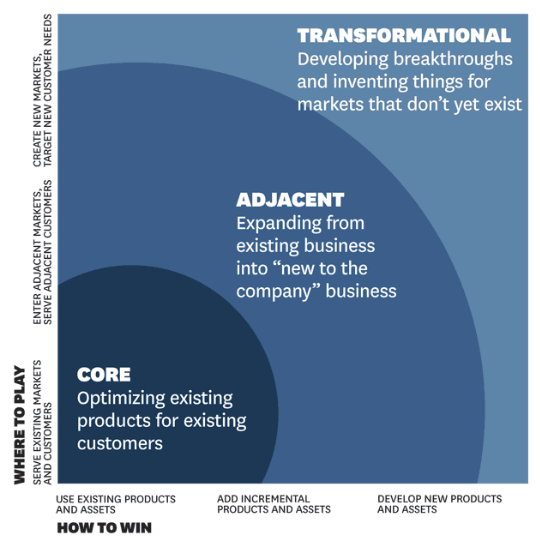
Discover | Define | Design | Distill
Innovation Ambition Matrix
Why?
How?
The innovation ambition matrix can help you identify where your new service-offering is playing or where you wish to play
Can also help to balance out your firm’s investment in innovation by determining what percentage of efforts to allocate to each of the three areas – the general “golden ratio” that firms such as Google employs is 70-20-10 (70% core, 20% adjacent and 10% transformational).
As an activity, the innovation ambition matrix shown below is drawn on a large piece of paper or projected onto a large surface (board, screen, etc.)
Participants then write their innovation contribution or idea onto a sticky note and place it in the corresponding category
If activity is being conducted with participants from different service lines, different member firms or etc., find opportunities to collaborate and leverage each others’ strengths
Discuss whether you are playing where you would like to or if there are opportunities to expand or limit to one or multiple areas
What?
Management tool and activity
The company’s current reality is represented by the bottom left corner; it then spans outward in the upper right direction to:
  Core describes the existing
  Adjacent describes what is new to us
  Transformational describes what is new to the market

Slide 12
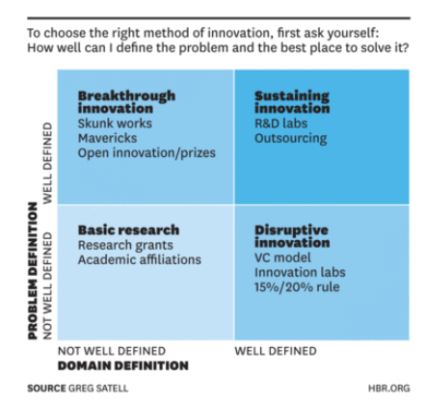
Discover | Define | Design | Distill
Innovation Question Matrix
Why?
How?
Before innovation can occur, it is important to identify which environment and market that the group is aiming to innovate in so that the solutions are relevant → i.e. first must develop a framework
Basic Research Keywords: Both undefined, therefore, on the cutting-edge of innovation or the creation of something that is completely untouched by the market
Breakthrough Innovation: Problem is well-defined but difficult to find the domains to get to the solution – consider combining existing domains to bring about the solution
What?
An innovation matrix that asks users two questions:
  1. Whether the Problem is Well-Defined or Not
  2. Whether the Domain is Well-Defined or Not
Depending on the answers to these two questions, everything following from the basic research to ideating to experimentation and so on will be different depending on the parameters that the team is working within
Sustaining Innovation: Both well defined but need to take advantage of both to continuously innovate
Disruptive Innovation: Domain is well-defined (e.g. better technology, facilities, knowledge) but as problem is not well-defined, it creates a situation of: “solution → need identification”, rather than the customary “need identification → solution”

Slide 13
Discover | Define | Design | Distill
SPICE
Why?
How?
Beyond surveys, interviews and questionnaires, observation-based Design Research delivers better depth and breadth of understanding which in turn, often uncovers unmet needs, gaps and new opportunities.
Designers use different frameworks to organize their thinking;
Social:
  Who’s in their circle?
  What does your stakeholder need from them?
Physical:
  What’s their physical environment?
  What do they interact with? Where?
Identity:
  How do they define themselves?
  Who do they “hang out” with?
Communication:
  What kind of information/knowledge do they need?
  And what’s their communication style?
Emotional:
  what’s their current state – psychologically?
Other frameworks:
AEIOU: Activities, Environments, interactions, Objects, Users
POEMS: People, Objects Environments, Messages, Services
Supporting Activities:
‘Day in the life of’ exercise to carry out the SPICE framework in
Contextual Enquiry: semi-structured enquiry on a specific task
Interview Process: interview the individuals for specific areas
What?
Like cultural anthropologists, Design Researchers observe stakeholders within their “natural” environment, to gain a deeper appreciation of their motivational behaviors, decisions and actions

Slide 14
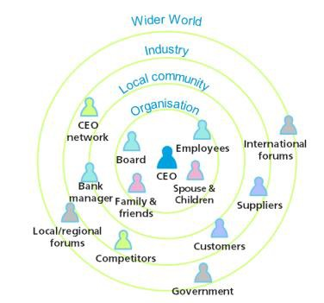
Discover | Define | Design | Distill
Ecosystem Maps
Why?
How?
Creates a clear, comprehensive picture of the system including the network of intersections, interactions and patterns
Ecosystem Maps help identify potential gaps, defines opportunities for improvement, highlights where value is being exchanged and where value is not being delivered
Discuss, identify and capture on a whiteboard, the system in focus
Imagine ALL the stakeholders in the system (direct and indirect)
Working with the team and subject matter experts, sketch the system as a whole, then accentuate the following key metrics:
  Value transferred and intersection points between groups
  Importance of each of the players in the system
  Individual motivations, interests
Differentiate each metric using different colors, pictures, line styles
NOTE: Stakeholder ecosystem maps should:
Reflect both internal and external stakeholders
Establish their relative importance to the project/problem
Detail their relationship with one another
Example of CEO Ecosystem:
What?
A 360⁰ visualization tool is used to highlight the connections between stakeholders within a complex environment
Ecosystem mapping can include: people, processes, technologies and business expectations within a product/service delivery system

Slide 15
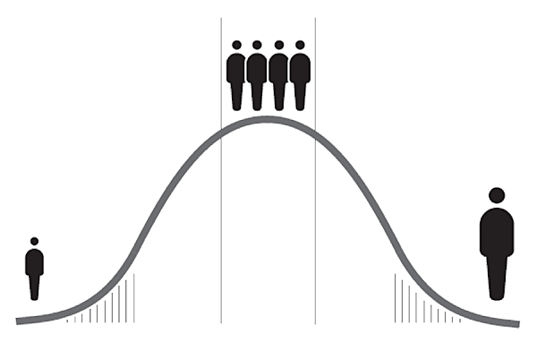
Discover | Define | Design | Distill
Extreme Users
Why?
How?
Extreme users’ needs are the needs of the larger population but more amplified and therefore, more noticeable and meaningful
It ensures that minorities are also considered and represented in your innovative process
To start, you will need to determine who is an extreme user based on the context of your environment space, your problem, the business model, etc. or more practical elements such as the time frame or budget available to work with
  Extreme users may include any group of special individuals depending on various factors such as age groups, geographical locations, attitude towards your offerings, attitude towards the adoption of technology, etc.
Engage with the extreme users through observation of their patterns during interaction points with your offering
Interview/directly ask about their needs and how they would work with your proposed innovative solution should you have one
While extreme users are a way to generate inspiring ideas, ensure that the general population in your customer segment are kept in mind
What?
Extreme users are the individuals that are on the extreme ends of a spectrum; if an idea is able to suit someone considered “extreme”, it will most likely suit all other users
Consider the perspectives of extreme users which can spark creativity and innovative thinking

Slide 16
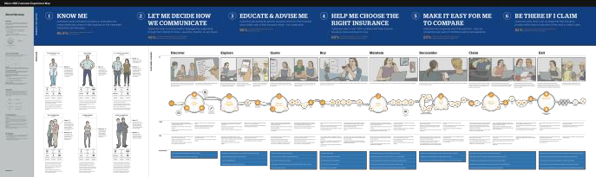
Discover | Define | Design | Distill
Journey Maps
Why?
How?
From the stakeholder’s perspective, it illustrates a variety of factors (good and bad) that impacts them
This is a fundamental tool in building an aggregate of knowledge and effective way to spot opportunities/weaknesses
Visualizing the journey allows comparisons between multiple stakeholders
The stakeholder research (or a ‘Persona’ if applicable) is the baseline from which to build a Journey Map
The goal is to create a clear picture of the stakeholder’s end-to-end experience, so try to record as many touch points as possible (e.g. in person encounters, physical environments, virtual, online, etc.)
Highlight the major phases in the overall experience, then progressively layer additional information gathered in each phase
To make the map more realistic and engaging, include photographs, quotes or commentary into your Map.
NOTE:
Journey Maps are useful as a diagnostic tool and can also be used to investigate and chart: process, systems or stakeholder expectations
What?
A visualization of the direct/indirect interactions that comprise a stakeholder’s end-to-end experience
A good Journey Map provides a comprehensive view of indicative touch points as well as captures the personal (emotional) journey at key stages along the way

Slide 17
Discover | Define | Design | Distill
Synthesis
Why?
How?
Synthesis process helps you take a holistic look at all the content, identify useful relationships, explore a range of ideas and make meaningful connections
Tell stories – meaningful connections
  Listen and avoid listing facts
Look for patterns
  Sort findings into different themes, try to uncover relationships between ideas
  Group and re-group: keep challenging your thinking to achieve the best results
  Get people outside your team to review your groups/themes, – fresh eyes will see alternatives and new options
Extract key insights
  Review all your findings/patterns – potential insights are thing that catches your attention, makes you think “What if?”
  Select and capture only your most significant insights
  Don’t worry about losing some detail at this stage
  Align the ‘level’ of insights (core-transformational)
Hypothesis time (see value position tools as well)
  What are the new stories based on your new insights?
  Test, refine and test your hypothesis again with people outside your team – do they understand what you are trying to convey?
What?
Synthesis is the art of making sense out of too much information. It is a process of pattern-finding that helps you filter and frame, categorize and theme useful/interesting ideas to uncover key insights

Slide 18
Discover | Define | Design | Distill
Service Safari Shadow
Why?
How?
Both service safari and service shadow are observation techniques in order to determine unique opportunities or best practices for the business
To conduct both a service safari and service shadow, you will need to contact the leaders of the service or process to schedule a time where you can conduct your observations
Ensure adequate preparation beforehand, for example:
  Questions directed towards the individuals who are in constant interaction with the service or offering
    what pain points they have, what improvements they suggest, what best practice do they employ?
  Questions directed at the customer segment should you be in contact with these individuals as well
  List categories or general subject headings to guide your note-taking process and organize your thinking
  Specific tasks to pay particular attention to
Every safari and shadow experience will differ depending on the service or process, ensure that you are flexible and adapt according to the culture or circumstances
Be sure to take detailed notes
After the physical observations, reflect on the entire process and map out action next steps to undertake
What?
Service safari is an in-person trip to physically experience the services or process through specific tasks undertaken throughout a period of time (day, week, month, etc.) to gain insight into (potentially multiple) specific areas
Service shadow is similar to a service safari but rather than following a task, it involves observation of a particular individual or group of individuals to gain insights into the patterns of the people carrying out or working closely with the service or process

Slide 19
Discover | Define | Design | Distill
Innovation Scenario Planning I
Why?
Example
To evaluate the implications of an innovative solution and its integration in all parts of how we work or socialize
Helps innovation users of today envision for the future and plan scenarios with the incorporation of the innovation
What/How?
A mind-map tool to visualize the impact of an innovative solution when it becomes widely adapted in the future
This scenario planning tool starts with a key scenario driven by innovation e.g. cashless society
The users list three implications from this scenario and for each implication, a second level of implication is ideated from the first level of implication
Mind-map Format:
  Level 1 Implication: 3 implications PER scenario
  Level 2 Implication: 2 implications PER L1 implication
  Level 3 Implication: 3 implications PER chosen L2 imp.
    Choose the key L2s and go one level deeper

Slide 20
Discover | Define | Design | Distill
Innovation Scenario Planning II
Why?
How?
To evaluate the future of a particular scenario on a scale of minimal to maximum technology and impact
While ideating tends to assume maximum impact and technology (as it should), it is important to consider the three other situations when defining possible outcomes
What/How?
A mind-map that shows four future possible conditions:
Users then ideate for the proposed scenario under each condition/environment
What would the future outcomes look like and which stakeholders are involved – users can develop an understanding for the environment and problems to take into the experimentation phase
Technology: Maximum Impact: Minimum | Technology: Maximum Impact: Maximum
Technology: Minimum Impact: Minimum | Technology: Minimum Impact: Maximum

Slide 21
Discover | Define | Design | Distill
“A Day in the Life of”…
Why?
How?
During the imagine phase of innovation, there tends to be a huge amount of ideas, each of them gems but unorganized – this tool brings together the ideas and applies them in a practical way i.e. applies them to the typical day of an employee/stakeholder/client at a future time
Allows users to evaluate the ideas that they’ve generated and find a good fit for it
Different Methods of Deliverables: Tell the story through:
Story-boarding: series of drawings/pictures that visualize a particular sequence of events
Writing the short story in a script and recording different parts to make a video – if widely communicated, consider animating
1./2. combined – storyboard and record dialogue over it
Present it in a comic book format
Present it in an interactive PowerPoint, Prezi, other online presentation tools, etc.
Build a model that can be shown/shared electronically
Application to a business professional – Ask the Following Questions:
What does an actual average day look like for the professional?
Is the innovative solution commonly used by the professional during the day? – How so?
Is there a change for the innovative solution to be used by the clients during their operations? – How so? How does that impact /change the way we provide services?
What?
An ideation technique that contextualizes a situation and allows the users to visualize and narrow the application of an innovative solution on a certain individual’s average day
For example, in the context of financial services, how does the introduction of a certain innovative solution e.g. cashless society affect the professional and/or the customer? – They would pay for their morning coffee and transit with electronic cash, then go to work and receive report of their client’s sales for the year as the electronic transactions are tracked and recorded

Slide 22
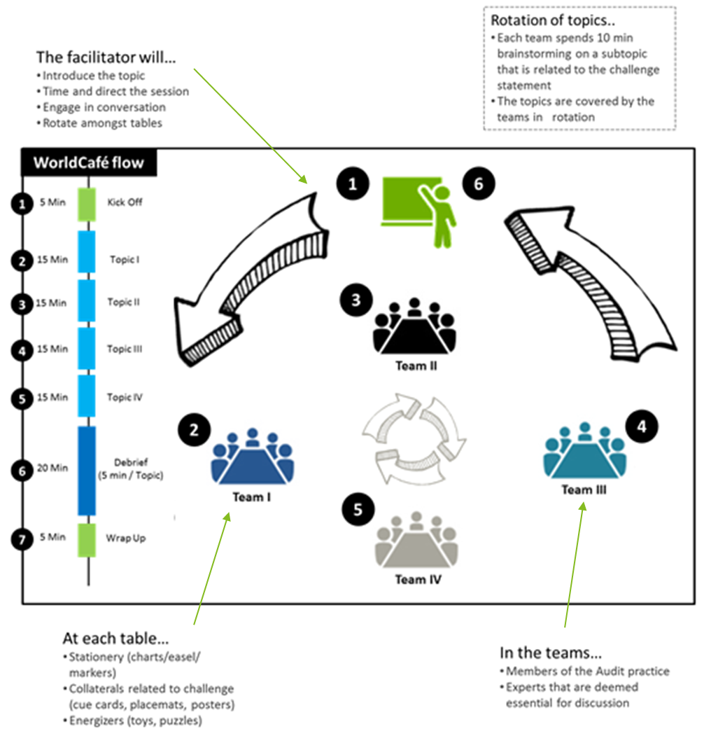
Discover | Define | Design | Distill
iCafés
Why?
How?
The rotation of subtopics of the main challenge helps participants look at the solution from various angles which helps increase the quality of output produced from the brainstorm
What?
iCafés are short facilitated sessions in which multiple teams provide a diversified perspective on an issue at hand
Somethings to keep in mind while you are participating in an iCafé can be effective:
  Writing only one idea per post-it note
  Don’t kill ideas, capture all ideas
  Don’t disregard time; time is precious in an iCafé

Slide 23
Discover | Define | Design | Distill
Analogous Solutions
Why?
How?
Participants who may be experiencing a block in their thinking or are feeling too boxed in when restricted only to innovating in a business context may be more inspired by a new environment
It’s hard to ask for a different perspective when nothing changes so by dramatically changing the surroundings, it’s easier to think differently
From the problem you’re trying to solve, list the distinct activities, behaviors, and emotions you’re looking to research
Next to each one, write down a setting or situation where you might observe this activity, behavior, or emotion. This is to identify a parallel situation. Name a completely different setting or environment from business services that is broad enough to draw comparisons yet not too vague to still be meaningful
People in the group innovating should then pick a parallel situation and go observe it
Each person in the group should try to do two tasks:
Find innovative or creative aspects of the new environment and try to create analogies and put it into the business context
Think about how you would innovate the new environment – what could they do to be disruptive? Then try to apply the same type of thinking to the business/industry environment
What?
Analogous solutions is an activity where participants draw upon ideas and solutions from an analogy of the working space or particular problem
i.e. innovating in an environment unrelated to the business, and trying to bring back workable, creative themes back into the business and the corporation's context

Slide 24
Discover | Define | Design | Distill
Hackathon
Why?
How?
Hackathons are a collaborative, competitive and separate environment for teams to focus solely on innovation rather than having it as a side project – they are encouraged to drive their ideas as far as possible
The hackathon model is also used as a tool to enable practitioners to experience how impactful Doblin’s structured innovation approach can be
There are a variety of options and approaches to running at Hackathon depending on your preferences and the scale of the event
A community hackathon can be put together quickly and run through a weekend to find a solution to a defined problem
Design-Driven Hackathons are more complex involving elements of a design sprint in combination with the typical hackathon model
  Frame: Kickoff event and align on objectives and research plan
  Discover: Develop insight in technology stimuli; technology/platform showcase and demo
  Analyze: Generate concepts by ideating based on research and precursors
  Create: Review, refine and prioritize concepts
  Hackathon Weekend:
    Develop Minimum Viable Product (MVP), settle on value proposition and develop business Model
    Perform customer validation and refine pitch
What?
A hackathon is an intense event spanning a few hours to a few days where participants are gathered from various fields (within organization or in the community) and they come together to focus all their energy on innovation to deliver solutions

Slide 25
Discover | Define | Design | Distill
Innovation Challenge
Why?
How?
Engage service professionals and practitioners and involve them in identifying new investment opportunities; receive a multitude of ideas for innovation directly from the professionals
Promotes a culture of innovation and challenges our professionals to elevate their innovative & critical thinking skills
When the challenge starts, each team will need to submit an idea by filling out the submission form; Keep in mind that the submission form should contain:
  Team name, Team leader, Team members
  Idea name, Idea description
  Value proposition: how will the idea align with the value proposition that you are trying to offer customers? Submission must be strongly tied to value
  What makes it a compelling idea?
  How is the idea aligned the division’s key strategic priorities?
  What are our competitors doing in this space?
After idea submissions are complete, facilitators will use the structure they set up during the planning phase of the innovation challenge to judge which submissions are considered top ideas which can be done through platforms that allow mass voting
A popular way to determine the final winner of the innovation challenge is modeled after the popular American TV show Shark Tank with a collaborative and competitive twist
  Top teams will go on to pitch their idea in front of the panel
  The final winner (or all top teams) will walk away with a pre-determined prize, usually a monetary sum that can fund the idea they developed through the innovation challenge
Ensure there is follow-up and try to push the idea into the market through hackathons, FastTrack, etc.
What?
Challenge that involves the practitioners where they are asked to submit innovative ideas that can potentially be used to drive an innovative process
How?
To run an Innovation Challenge, a facilitating team needs to set up the challenge and clearly outline and communicate the rules
  Define the purpose of the challenge: what the ask/concept of the challenge will be
  Setting out the strategies and goals that they’d like to accomplish
  Define the incentive – what will the prizes look like?
  Identify what tools, technology, resources to use to keep track of the challenge
  Define how will the teams be judged and ranked

Slide 26
Discover | Define | Design | Distill
Brainstorming
Why?
How?
One of the simplest and inexpensive methods of generating a multitude of ideas, some of which can inspire a solution or creation of a process
Traditional Group/Individual Brainstorming: Think freely and creatively on your own OR leverage the group’s diverse experiences as you brainstorm together
Brain-writing: based on the concept that idea generation should be separated from the discussion piece; brainstorm individually on a piece of paper at first before coming together as a group – this prevents initial ideas from being influenced by others
Reverse Brainstorming: Rather than thinking of solutions to problems, think of how to cause the problem, then how to prevent the cause
SCAMPER Technique: Brainstorming technique that stands for:
  Substitute: Remove and replace parts of the process
  Combine: Join together parts of the process
  Adapt: Adapt the nature of the process or problem
  Modify: Change all or attributes of the process or product
  Put to Other Use: Can it be used for another purpose
  Eliminate: Imagine the removal of parts or all of the process
  Reverse/Rearrange: Change the sequencing of the process
What?
Brainstorming is a classic technique in creative thinking – essentially, it is imaging intensively on a problem, situation, opportunity, etc. in an open environment

Slide 27
Discover | Define | Design | Distill
TRIZ Principles
Why?
How?
Although better suited as strategies for goods and products, some principles can be adapted to fit a service need or potential process improvement
The recommended five principles out of the forty:
Principle 2: Taking Out
  Separate out unnecessary, distracting or interfering parts of the process
  Single out only the core necessary part
Principle 6: Universality
  Make a process perform multiple different functions which eliminates the need to have other processes
Principle 23: Feedback
  Use feedback in order to improve a process or action
  If there is feedback already , change its magnitude or its influence
Principle 24: Intermediary
  Use an intermediary process or temporarily merge two processes
Principle 35: Parameter Change
  Change some parameter about the service itself or the environment that it operates in
Use these principles as a guide or a direction to take when you are generating ideas for innovation
What?
The 40 TRIZ Principles (“Theory of Inventive Problem Solving”) are a methodology of creating inventive solutions to challenging problems developed by Genrich Altshuller and continues to be relevant and used decades after creation

Slide 28
Discover | Define | Design | Distill
SIT Principles
Why?
How?
SIT principles are used as a way of generating inventive solutions to challenging problems generally focusing on product innovation although they can be adapted to inspire service and/or process innovation as well
Use the following 5 principles as an inspiration, a general guide or a direction to take your innovative process (think of these principles loosely rather than adhering to them strictly):
Principle 1: Subtraction
  Something that seemed essential to the produce/service is removed
Principle 2: Task Unification
  Tasks combined/unified with a component of the service where there was no clear link
Principle 3: Multiplication
  A particular component is copied and altered slightly even when there doesn’t seem to be any purpose in the alteration
Principle 4: Division
  Service/process component is divided out of their normal function and placed somewhere else in the process
Principle 5: Attribute Dependency
  Two attributes that don’t have a clear correlation are linked so that when one attribute changes the other responds
What?
The 5 Systematic Inventive Thinking (SIT) principles, similar to the 40 TRIZ principles, are based on the idea that every innovation has the same pattern

Slide 29
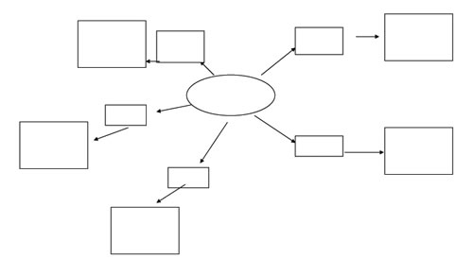
Discover | Define | Design | Distill
Mind Map & Flower Association
Why?
How?
Mind Mapping gives structure and clear organization of information so you can see how pieces fit together and in which direction they lead to
On a blank canvas of any medium (e.g. blank paper or computer draw tool), start with the main subject or problem in the center and circle it
Then branch out with subcategories that break down the main subject or problem and write it out on the line
When a new idea or piece of information can be linked to a branch, encase it in within another circle
Optional designs for more clarity:
  Decrease the size of the arrow as you dive deeper
  Change colors for major subsections of the mind map
  Highlight areas of real potential and how they link back to the main subject or problem
Flower Association:
Starting with main idea, theme, subject or problem in the center and then generate associating ideas around it like flower petals
Use each petal as a new center and generate more/secondary associating ideas which may lead to new inspiration
What?
A visual way of brainstorming ideas by focusing on a particular problem or ask and then expanding the ideas outwards in a chart/map
Flower association (also known as the lotus blossom technique, flow association, etc. other variations) is a more structured technique to visually represent connecting ideas

Slide 30
Discover | Define | Design | Distill
Low Fidelity Prototypes
Why?
How?
The Prototyping process of ‘test, fail, learn, refine’ fuels deeper understanding, builds certainty and facilitates decision making, which ultimately helps minimize financial risk.
Conduct many small experiments rather than a few big ones
Identify assumptions to be prototyped and create a Prototyping Plan:
  What is the learning objective? Why is it important? Risks?
  What are the required resources? People, time, material, etc.
  What does success look like? (Not necessarily financial)
What form will the experiment take? One or more of combinations:
  Create a storyboard
  Create diagram
  Create narrative/story
  Create sketch mock-up
  Create 3D model
  Create role play (good for service/experience)
  Create a promotional ad
Test the prototype by reviewing with colleagues, key stakeholders, friends, clients, etc.
  Capture the evolution as the prototype evolves over time (notes, photos, videos) – record any ‘unanticipated learning’ to share with others
  Summarize what has been learned at the end of the test and take them into the next cycle of design
What?
An inexpensive, quick albeit controlled experiment to test one or more assumptions.
A prototype is a tangible representation of an idea or hypothesis that can be shared, tested and learned from.

Slide 31
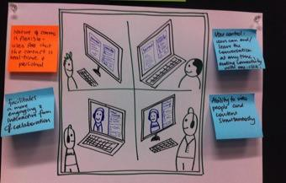
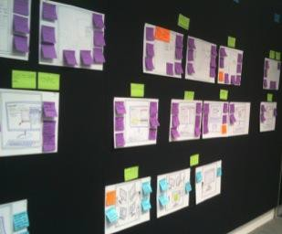
Discover | Define | Design | Distill
Storyboard & Service Blueprint
Why?
How?
Storyboards allow stories about user experiences to be brought into the design process
Putting the service situation into a creative context:
  Provide fresh perspectives on service or prototype
  Encapsulate the experiences of people using the service
  Provoke meaningful, value driven analysis
  Sparks discussion on problems and opportunities
The objective: the story is to include as many contextual details as possible, so that anyone viewing it will be able to quickly grasp what is going on.
When used in a co-design workshop, the storyboard should be able to convey the key aspects of a service or prototype in a straightforward a manner as possible.
The aim of the story board is to gain insights into the user experience being depicted and can incorporate several contrasting outcomes.
Storyboards can be constructed in a number of different ways:
  Comic-strip format, in which a series of illustrations tell the story of the situation being examined
  Real life or imaginary scenarios can be used, with the former occasionally being documented in photographs as opposed to illustrations
  Service Blueprint: the process is mapped out with the following components:
  Stakeholders’ actions, physical evidence, support processes
  Lines of visibility: separating out the services visible to clients
  Lines of interaction: directly between the firm and clients
  Lines of internal interaction: between practitioners and internal support employees
What?
A storyboard is a series of drawings or pictures that visualize a sequence of events
May be a common situation where a service is used, or a hypothetical implementation of a new prototype

Slide 32
Discover | Define | Design | Distill
FastTrack
Why?
How?
Using fast track has a variety of benefits:
Dedicated time and focus: Expert Coaching
Cross Functional Collaboration
Clear Marketplace Focus
Gate Session: A panel of diverse senior partners with experience in multiple service lines and industries reviewed each team’s business model, provided feedback and determined whether the teams were ready to proceed to the final go to market stage of the program
Immediate Results: Reduced time-to-market by creating a sharpened business case, improved offering, and concrete go to market plan
Pre-Program Preparation:
  Outside-In Approach and Team Design
  Teams identify and discuss offerings prior to program
  Teams pitch offerings in the market to potential clients
  Market feedback is collected by the Fast Track team & shared with team at start of program
  Teams are formed based on participant profiles, competencies
48 Hour Pressure Cooker Development:
  Business Case and Go to Market Plan
  Internal and external facilitators lead 48-hour pressure cooker
  Teams build and refine offering
  Teams create business case
  Teams develop concrete go to market plan
  Teams work on packaging their offering (branding & marketing)
Post-Program Go To Market:
  Executive Coaching, Support & Funding
  Teams present business cases to innovation council
  Innovation council makes final decision on funding and development
  Teams go to market with new offerings!
What?
This 48-hour facilitated innovation pressure cooker can be used internally or with clients to take a close look at new and existing products and services to boost business in the short term. The program allows new ideas to move quickly from concepts to business cases for immediate results.

Slide 33
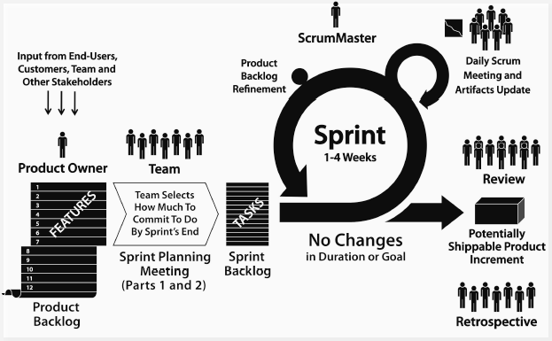
Discover | Define | Design | Distill
SCRUM
Why?
How?
Manages the flow of many projects as it identifies user stories with high priority to Sprint into a potential creation with the others in backlog
Components of a User Story:
Story’s description serves as an identification, reminder, helps planning
Generally in the form: “As a [role/user/stakeholder], I want/need to [function/need], so that [value to user/condition]”
  Role/User: who is the user?
  Function: what process/activity is the user trying to complete?
  Value to the user: why does the user need to be able to do this?
Details are in the dialogue carried out with users and team which identifies criteria and constraints: Recorded notes, Use case/SRS, Wireframe, Additional analysis (i.e. Excel), Design documentation
AVOID: getting too detailed, writing in terms of implementation technology, ignoring the business value by repeating the what
What?
SCRUM is an agile framework for project management; one of the most crucial components is the user story
A user story is a high-level definition of a requirement, containing enough information so that the teams can produce a reasonable estimate of the effort to implement it
Epics are large user stories requiring more than one iteration; low priority
Themes are a collection of related user stories; used to organize stories into releases or so various sub teams can work on it

Slide 34
Discover | Define | Design | Distill
Extreme Wishing
Why?
How?
For the more out-of-box disruption to occur and to understand what exponentials can possible, a more extreme way of thinking is sometimes necessary
Disregards the boundaries and limitations of today’s technology and society and pitches to a future audience in a future market
Participants will sit together at the table and identify pain points
Then participants will let their imaginations make “extreme wishes” i.e. ideate solutions that do not seem feasible at the current time because of technology/regulatory/practicality reasons
After the “extreme wishes” are written, the strongest few are identified, and the participants begin ideating on the smaller, more practical steps in order to get to the future solution
The group is the encouraged to bring back the restraints that were ignored in creating the “extreme wish” one by one and ideate on how to work around or overcome these restraints
How it will affect the business component:
Participants are encouraged to discuss how each step in the journey to achieve the “extreme wish” will affect the business – in terms of the professionals, the regulations, the guidance
How will the operations or go to market strategies be moved by this? Focus more on value add-ons rather than searching for and documenting support? – what do these value add-ons look like?
How it will affect the stakeholder's component:
Participants are encouraged to discuss how each step in the journey to achieve the “extreme wish” will affect the different stakeholders (whether internal or external) that are involved
What?
An ideation technique which requires users to think of an end solution or potential exponential that cannot be created or facilitated in the short term

Slide 35
Discover | Define | Design | Distill
Semantic Intuition
Why?
How?
Allows a group to potentially create a unique idea or story that would not normally have been reached through the normal and logical process
Either as an ice-breaker for a new group of participants or at the end of a session when participants feel that their creative juices have been drained, the facilitator introduce this tool.
The facilitator first identifies the innovative problem which requires the team to ideate a number of outcomes for → Based on this information, the participants first write one/two key words on a slip of paper that logically relates to the topic at hand
Then the slips of paper are put in a box, shuffled and at random three slips of paper are pulled out – alternatively keywords can be written onto a spreadsheet and a random generator can combine the keywords
Using the keywords, the group will start ideating stories and solutions that use the keywords; there are a number of ways the ideas can be created
  By using all three keywords in the solution and story
  Using different variations of the keywords to generate the solution
  Categorizing the keywords and generating ideas within each category before combining it together
  Group can be split into smaller sub-groups to generate ideas on each keyword before coming together and combining their ideas
To gain the most benefits from this tool, facilitator should implement a “no rules” policy as to how the keywords are used in the solution and allow the group to go on a wild tangent where they may ultimately stumble across a truly unique idea
What?
An ideation technique which requires the group to ideate and build a story around a random topic
It can be used as an ice-breaker as it encourages active discussion and since the tool itself incorporates a random component, the environment becomes a safe space for individuals to share the more wacky, crazier ideas
It can also be used if the facilitator finds that the group’s creative juices are tiring or if their ideas are too “safe”

Slide 36
Discover | Define | Design | Distill
Triggered Brainwalking
Why?
How?
A good tool that allows participants to build off of each others’ ideas and requires everyone’s inputs
Ensure a balanced participation as opposed to a verbal brainstorming session which is often dominated by the outspoken members
After a problem requiring an innovative solution has been defined, the team works together to break it down into workable components
The team then selects components that they wish to further explore and ideate on
Then the facilitator will provide each participant with a packet of sticky notes (or tape a large chart sheet onto the wall)
Each participant will then take some time to write their initial and/or strongest idea onto the sticky note and place them in a row on a board/wall (alternatively, will write on separate chart sheets)
Then the participants will rotate one spot to their left/right and add-on another sticky note below the initial sticky note that expands on the idea and incorporates the second individual’s thoughts and opinions – this process continues until all participants have written something for each of the ideas
This process can be done either in silence and debriefed after all the ideas have been written on the sticky notes/chart sheet or the discussion can happen during the writing process depending on the result that the facilitator would like to achieve
What?
An ideation technique where participants work together and build on each other’s initial ideas to define an innovative solution and identify a big picture that incorporates the thoughts of every member

Slide 37
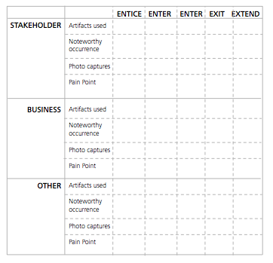
Discover | Define | Design | Distill
Five E’s
Why?
How?
It is a diagnostic tool, used to locate research findings in each of the 5 fields contextualizing the end-to-end experience
Once complete, a picture forms on where needs are undeserved, calls out potential gaps/ opportunities and facilitates decision making
Once illustrated, potential areas for improvement, new products or services are identified
The Five E’s are as follows:
ENTICE: How is the stakeholder attracted to, informed of the service?
ENTER: How does the stakeholder begin dealings with the organization?
ENGAGE: What focused activities are conducted in delivering the work?
EXIT: What does the stakeholder leave with? What happens after?
EXTEND: How do you follow up with stakeholder?
Building on Journey maps, etc., select two endpoints that relate to the service or process being designed and begin
Chart the sequence of events/interactions the individual goes through, capture observations/ideas/insights on Post it Notes and place them in their respective field
What?
The Five E framework is a visual tool that transforms the findings uncovered in stakeholder research into a sequence of events/elements that comprise an end-to-end experience
It is a comprehensive picture from multiple perspectives
5 E’s can go through these different channels:
Artefact Channel: list the artefacts (brochures, device, etc.) used to enable the experience
Noteworthy Occurrence Channel: list all things that happen
A Photographic Channel: capture visuals of the experience
Pain-point Channel: lists all the pain-points relating to field
‘Other’ is for any third party that impacts the experience

Slide 38
Discover | Define | Design | Distill
Decision Tree
Why?
How?
Provides a balanced picture of the risks and rewards to create clarity of choice between several courses of action
As you brainstorm ideas, draw lines out from the box towards the right and write the idea on the line
Keep lines far apart to expand
Consider the results and at the end of each line, then draw either a:
Circle: if the result of the decision is an uncertain outcome (circle = uncertainty)
  Above the circles, write the key factor to consider – starting from the circle, draw lines for possible outcomes, each line should describe ramifications of the outcome
Square: if the result is another decision that needs to be made (square = decision)
  Above the squares, write the decision – starting from the new decision squares, draw out lines representing the potential options
Repeat process to explore and develop as many outcomes/decisions as possible from the original decision
If the end of a line represents a complete solution – leave it blank
What?
Visually-driven structured thinking process that facilitates decision-making in situations where there are multiple alternatives with unknown implications
Diagram resembles tree branches – shows connections between possible outcomes

Slide 39
Discover | Define | Design | Distill
2x2 Matrix & SWOT
Why?
How?
Rather than statistics, a 2x2 matrix is simple and it can visually convey and put into perspective a large amount of data to see its value
The SWOT analysis can help the user understand the position and value of their plan or process
The 2x2 Matrix is basically a Cartesian plane where you compare two variable by putting one of them on the x-axis and labelling it LOW and HIGH, and the other variable on the y-axis also labelling it LOW and HIGH
Then plot specific objects or points onto the Cartesian plane i.e. if the object has low X-variable but high y-variable, it will fall somewhere in the upper left quadrant
For more factors that you wish to introduce besides the 2-dimensional x and y, consider using different colors and different sizing to label the object/points; keep track of multiple factors using a legend
A SWOT analysis uses a 2x2 matrix (without the variables) as it specifically labels each quadrant one of the four categories:
  Strengths to highlight the strong positive points
  Weaknesses to highlight the weak negative points
  Opportunities to describe places of growth or expansion
  Threats to describe possible competition, disruption, etc.
What?
2x2 matrix is a consulting tool that represents multiple dimensions of data visually and intuitively
A version/variation on the 2x2 matrix is the SWOT analysis where each of the four quadrants is categorized by SWOT – Strength, Weakness, Opportunity, Threat

Slide 40
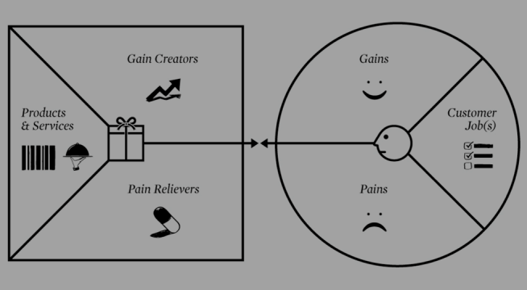
Discover | Define | Design | Distill
Value Proposition Canvas
Why?
How?
The canvas is a good visual to easily map out and find the relationships between features of your value proposition and the characteristics of your customer segment
It is also an essential plug in to the business model canvas as it utilizes two of the nine building blocks/components
In reference to the above diagram, the right portion of the image is where you should place your customer segment profile which is comprised of:
  The jobs they are trying to get done and the needs they have
  The pain points relating to their jobs/needs
  The gains/benefits they hope to achieve
The left portion is where you should show the features you designed for value proposition and is comprised of:
  The product/services you offer to help customers get a functional, social or emotional job done
  How it acts as pain relievers to specific pain points
  The gains/positive outcomes that you will create
If the features of your value proposition perfectly match the customer segment profile, then there is problem-solution fit
If the market validates your value proposition in the form of real return to the company, then there is product-market fit
What?
This framework is used to design a perfect product market fit
Tool that helps design, build, test and manage your value proposition to your targeted customer segment and shows you whether there is a good fit (or not)

Slide 41



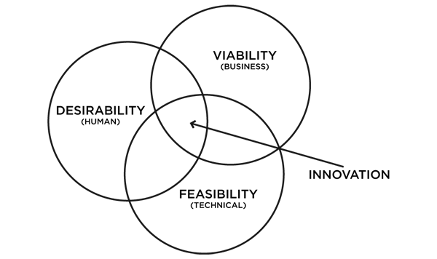
Discover | Define | Design | Distill
IDEO Design Model
Why?
How?
It illustrates the correlations between organization drivers and innovation outcomes when designing products, services, experiences and business models
IDEO Design Model helps to support and identify initial value proposition
What?
Global design consultancy IDEO popularized the Design Model framework that helps to find the area where it provides value to the people (your clients), is within the business and technological capabilities of the firm

Slide 42
Collaborative Tools | Collaborative Assets
Design Principles
Why?
How?
Using these principles is important in facilitating a thoroughly effective and valuable innovation process
Through the Innovation process, practice these principles:
Focus on Human Values
Empathy for the people you are designing for is critical.
Show Don’t Tell
Communicate your vision in a meaningful way by creating an experience, use illustrative visuals, tell a good story.
Craft Clarity
Produce a coherent vision out of messy problems. Frame it in a way to inspire others and to fuel ideation.
Embrace Experimentation
Prototyping is not just a way to validate an idea; it is an integral part of the innovation process. We build to think and learn.
Radical Collaboration
Bring together innovators with varied background/ viewpoints. Breakthrough insights and solutions emerge from diversity.
Be Mindful of the Process
Know where you are in the innovation process, decide what tools to use, and remember what your goals are.
What?
A set of principles adapted by Design Essentials from Stanford’s d.school to be practiced throughout an innovation process

Slide 43
Collaborative Tools | Collaborative Assets
TTPPEE Analogy
Why?
How?
The 6 areas cover most of what goes into promoting and building an ‘intrapreneurial’ culture that among your innovation team
Use the following sports methodology as a framework or checklist to ensure a comprehensive innovation environment/culture:
TECHNICAL: identify people with the right technical and abstract skillsets and abstract perspectives to develop and execute ideas
TACTICAL: develop a plan to identify and execute new ideas or enhancements with a clear process and direction to follow
PHYSIOLOGICAL: provide a physiological environment to enable an innovative mindset, know your team and their business chemistry and ensure people know what ‘hat’ wear
PHYSICAL: determine the place needed for collaborative team discussions (i.e. Hub) and establish how to work as a team
ENVIRONMENT: ensure work environment has minimal distractions including external as well as other work distractions (e.g. when not 100% dedicated to the project)
EQUIPMENT: Make sure to be comfortable with the tools and processes used and understand how it helps achieve the desired step
What?
A sports methodology that is used to help create and facilitate a collaborative team environment

Slide 44
Collaborative Tools | Collaborative Assets
StrengthFinder
Why?
How?
Everybody has strengths or talent in select areas; by discovering where your strengths lie, you can determine where most of your energy should be focused on
The Clifton StrengthsFinder assessment and Gallup Strengths Center are two online assessments; take them in order to then access your top 5 strengths or purchase the premium account for access to the full list of 34 strengths
Individuals who complete the online assessment also receive access to a variety of reports including in-depth analysis of your strengths, how to develop and capitalize on your strengths and learn what actions to take for each strength
What?
The Clifton StrengthsFinder hosted by Gallup helps users to identify their strengths and also understand and maximize them
StrengthFinder notes that “People who use their strengths every day are six times more likely to be engaged in their work and three times more likely to say they have an excellent quality of life”

Slide 45

Collaborative Tools | Collaborative Assets
6 Thinking Hats
Why?
How?
Helps to focus the thinking in a certain perspective, direction and/or approach
The facilitator should direct which hat the group should put on – can also be specified by the innovative process itself e.g. mark on the instructions of an activity, which hats to wear
Alternatively, can have different individuals wear different hats according to their natural personality inclinations or strengths
The 6 Thinking Hats are as follows:
  WHITE HAT – NEUTRAL AND OBJECTIVE
    Symbolizes the bare, factual information, data and knowledge that is available and/or needs to be collected
  RED HAT – EMOTIONAL AND PREFERENTIAL
    Symbolizes intuition, personality, emotions and biases without needing to justify them
  YELLOW HAT - OPTIMISTIC
    Symbolizes positive outlook; look for what the value and benefits are
  GREEN HAT – CREATIVE
    Symbolizes new possibilities and ideas; tries to generate growth
  BLACK HAT – DEVIL’S ADVOCATE
    Symbolizes critical thinking and cautious judgment
    Warned against overuse as it can cause innovation to stagnate
  BLUE HAT – THINK BIG PICTURE
    Symbolizes the control center that gets everyone back on track
    Asks for decisions and conclusions
What?
Thinking processes are separated into 6 categories represented by different colors of hats
Each hat is a different role or function that the user adopts when they are metaphorically ‘wearing’ that hat

Slide 46
Collaborative Tools | Collaborative Assets
Fact or Fiction
Why?
How?
The activity allows everyone a chance to speak in front of the group/team and to be comfortable and more confident in doing so
It also allows the team to get to know each other better either through interesting facts or creative untruths which can drive more small talk conversations in between business discussions
Go around in a circle, or whichever way allows all participants the opportunity to speak, each person says 3 things: 2 facts and 1 fictional sentence/phrase/story about themselves
The rest of the group then needs to decide which is fictional
Afterwards, discuss interesting facts about one another – things that are unexpected and out-of-the-ordinary
Reflect: did someone who appeared to be very shy do daring activities like skydiving on a regular basis? What prejudices did this activity break down for you?
Apply the mentality of “expecting the unexpected” and going “beyond the ordinary” to the entire innovation process
What?
A popular ice-breaker where each person gets the chance to speak about themselves
The rest of the group then needs to decide if what that individual is describing is fact or fiction

Slide 47
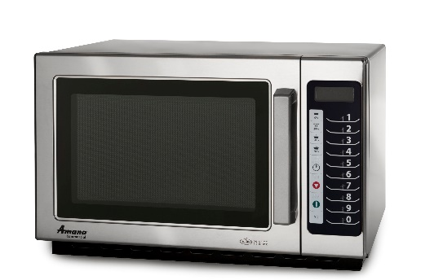
Collaborative Tools | Collaborative Assets
Your Everyday Innovation
Why?
How?
Innovation may seem daunting to tackle at first so it becomes more approachable if you can relate it back to real examples
Your Everyday Innovation can help you see how other people define innovation in their life and how it differs from your definition
May inspire you to think differently about the typical objects that surround you daily and provide you with a different perspective to take into idea generation
Participants take turns naming different objects commonly found in their everyday life and which aspects of it are innovative – if object is accessible, a live demonstration can be done
Others can join in on the discussion with their opinions – do they find some other aspect of it innovative? Was the object revolutionary when it first came out? How so? How did it cause people to work/move/live life differently
  E.g. microwave allowed us to have heated food in a matter of minutes and in a tight compact space which is also portable to a certain degree (definitely much more so than an oven or stovetop)
What?
A quick way to jump start the creative juices by having each user name an everyday object that represents innovation to them or in their lives

Slide 48
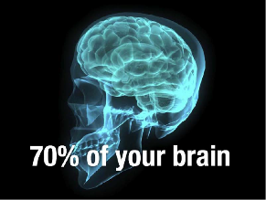
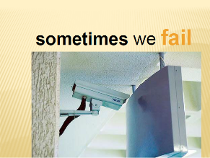
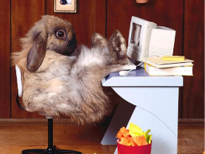
Collaborative Tools | Collaborative Assets
Power Point Karaoke
Why?
How?
Forces participants to speak in front of the group and become more confident and comfortable doing so, especially if the group is comprised of people with no previous interaction
Loosens the atmosphere as the activity is usually humorous and is a relaxed parody on the stiff, strict business Power Point presentations
A facilitator first prepares, beforehand, a set of slides that the group has never previously seen
  Slides can have pictures or a few directive words
The topic being presented can be:
  Limited to innovation/creativity or even more specific (project-related)
  Randomly drawn from a preset list (e.g. hat/box/etc.)
  Whatever the presenter chooses after seeing the initial slides
Presentations should be limited to 3-5 minutes so that everyone can have a chance to participate
Reflection questions at the end:
  Did the presentations inspire you?
  Did they make you think or react in a different way than you expected?
  If you had received one of the other topics/slides, which direction would you have gone in? Would you like to share that with the rest of the group/
What?
Also known as “Battle Decks”, Power Point Karaoke is an improvisation activity that requires participants present a cohesive slide deck they have never seen before

Slide 49
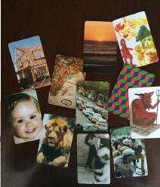
Collaborative Tools | Collaborative Assets
Photo Introduction
Why?
How?
Fun way of introducing yourself while using a prop to help guide what you’re speaking on or to use as a crutch if the person is shy or nervous
Can see each other people’s thought process as they are trying to relate their own story to the photo
A facilitator should have a pre-made set of photo card that are then spread across the table
Participants then go and each take a picture and take turns introducing themselves by using the picture is some capacity
Alternatively, participants can pick a number of pictures, order then sequentially, and then tell a story about themselves
Pictures can be of random objects, inspiring quotes, relate to innovation or creativity in some way (abstract or otherwise) or participants can bring their own pictures
What?
Photo introduction is an activity where participants choose a picture and then use it as a prop to help introduce themselves

Slide 50
Collaborative Tools | Collaborative Assets
Polleverywhere
Why?
How?
Quick easy way to grab data from a group of people and also visually display it either back to the group or for your own purposes (e.g. presentation, on your website)
Three steps to creating a poll:
Ask your question; create your poll:
  Multiple choice (incl. true/false)
  Free response
  Clickable images
  Q&A/brainstorm
  Foreign language functionalities, etc.
Participants respond after you decide the voting options:
  SMS text voting; most type of phones are supported as long as it has texting capabilities including international phones
  Web voting: Link participants to your PollEv voting page
  For premium users, there is also the option to customize the voting experience e.g. to match company branding
Real-time, live results
  Can see the votes or websites click reflected in the poll as they happen in real time – graphs will morph with data coming in
  The results can be viewed directly from the website, downloaded to be integrated into a PowerPoint or published onto your personal website (social media or otherwise)
The premium version also offers a variety of other features such as larger audience sizes, multiple users of the account, moderation, reports, keywords, team competitions, etc.
What?
Polleverywhere is an online poll generator where you can gather live response data to any question you ask

